Slide 1
R for Environmental Data Analysis
Jory S. Hecht
June 19, 2017
Basin Resilience to Extreme Events
Vermont EPSCoR

Slide 2
Workshop overview
R Skills
Introduction to basic data types and commands
Basic statistical operations
Programming efficiently with “for loops” and “apply” functions
Data visualization
Tips for learning more R on your own
Hydrology/General Data Analysis Skills
Data cleaning
Describing streamflow (discharge) variability
Relating precipitation and streamflow data at different timescales
Computing extreme floods with given recurrence intervals

Slide 3
Workshop outline
Basic R data types, objects, and commands
Daily mean discharge time series
Relating daily precipitation to daily mean discharge
Flood frequency analysis

Slide 4
R background
Developed from S statistical software
Free open-source software used in natural and social science disciplines
Users can create functions and packages
Core group regulates key functions, but extensive user community contributes
Advanced statistical and graphical capabilities
“Hard things are easy, but easy things are hard”
- Common complaint from beginning R users

Slide 5
Common data types (modes) in R
Data type | Examples
Numeric | 0.54, 3, 4.66
Integer | 1, 2, 3
Logical | TRUE, FALSE
Character | a, b, c

Slide 6
Dates and times in R
Data type | Examples | Comments
Date | 6/19/2017 | Does not include times
POSIXct (Calendar time) | 6/19/2017 10:00:00 AM EDT | Stored as the number of seconds since the beginning of 1970
POSIXlt (Local time) | 6/19/2017 10:00:00 AM EDT | Stored as a collection of numeric vectors of various time components

Slide 7
Common types of objects
Object type | Description | Comments
Vector | One dimensional variable | Includes scalars
Matrix | Two-dimensional variable | All columns must have same mode and length
Array | N-dimensional variable | All columns must have same mode and length
Data frame | Two-dimensional dataset, can have different data types | Similar to an Excel spreadsheet, columns must be of equal length
List | Ordered collection of objects | Can contain different object and data types of different lengths
Factor | For nominal (categorical) data | Can order factors on a scale

Slide 8
Apply functions
Quick way of applying functions across rows and columns
To average across rows:
apply(TSI,1,mean)
To average across columns:
apply(TSI,2,mean)
Variations for:
lists (lapply, sapply)
subsetting (tapply)
Hypothetical Trophic State Index (TSI)
Year | Jul | Aug | Sep | Mean
2012 | 50 | 70 | 70 | 63.3
2013 | 60 | 80 | 60 | 66.7
2014 | 50 | 60 | 40 | 50.0
Mean | 53.3 | 70.0 | 56.7
TSI > 50 → eutrophic

Slide 9
Array example
Let’s explore different climate and land-use changes with the IAM:
27 Scenarios total (3 x 3 x 3)
Create an empty array to store IAM simulations
Scenarios <- array(NA, dim=c(length(dT),
length(dP),
length(dAg))
 | Future State1 | Future State2 | Future State 3
ΔTemperature (°C) | 0 | 2 | 4
ΔPrecipitation (%) | 80 | 100 | 120
ΔAgricultural Land (%) | 90 | 100 | 110

Slide 10
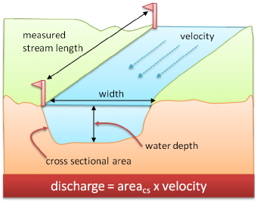
USGS streamflow data
The US Geological Survey collects and manages streamflow data at stations throughout U.S.
Data includes continuously recorded discharge estimates
Measured in ft³/s (cfs) in US (m³/s abroad)
Periodic field measurements establish relation between water level and discharge
We will look at:
Daily mean discharge
Annual instantaneous peak discharge
www.researchgate.net

Slide 11
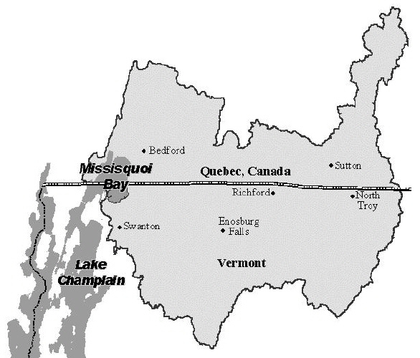
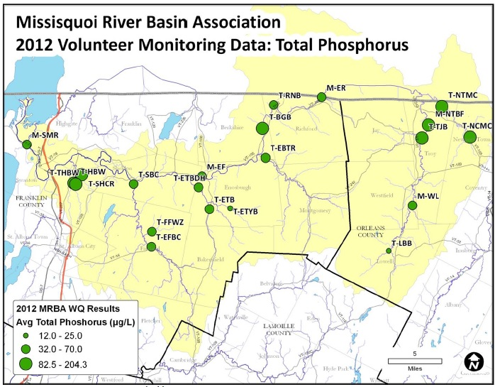
Missisquoi Bay basin
Extremely high phosphorus loads causes regular algal blooms
Missisquoi River has streamflow gauging station at Swanton (1990-current)
Two precipitation stations at Enosburg cover same period
Must be careful making conclusions with records < 30 years long
Enosburg
Swanton

Slide 12
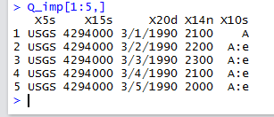
Let’s look at the data frame
OPERATOR
STATION ID
DATE
DISCHARGE
DATA QUALITY
Less accurate data

Slide 13
For loops
One method for running tasks repeatedly
Can be problematic with large data sets
Can state conditions to control looping
Need to create object to store output
For (i in 1:10){
XX[i] <-ifelse(i%%2==0,"even","odd")
}

Slide 14
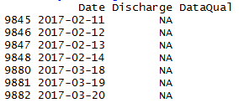
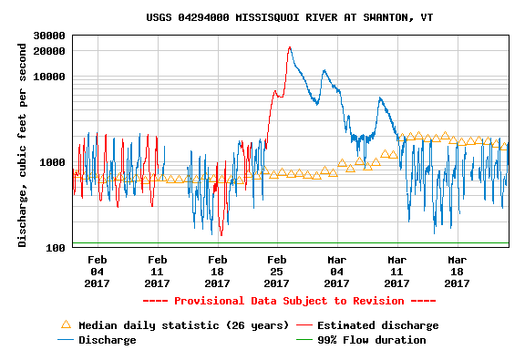
Missing data
All days without data in 2017
Provisional data subject to revision
River ice effects could be in play
Provisional data corrected within ~2 years usually

Slide 15
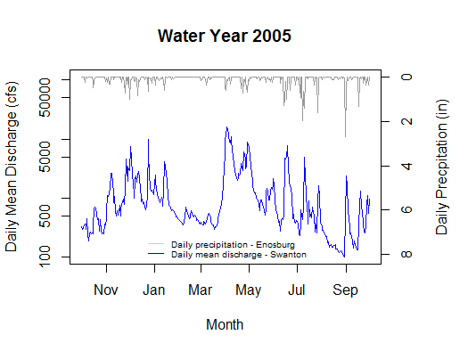
Water years
In the United States, run from Oct 1 – Sept 30
For instance, Oct 1, 2016 marks the start of WY 2017
Streamflow often reach annual low during late summer/early fall
Chosen for places with winter/spring peaks, summer/early fall recession

Slide 16
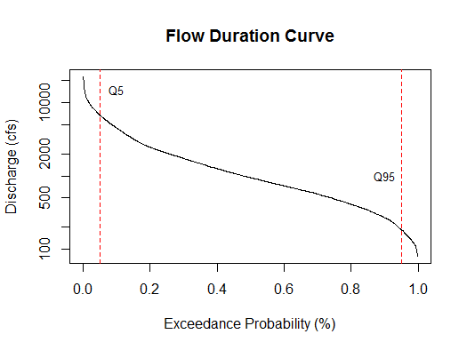
Period-of-record flow duration curves (FDCs)
Flow durations describe how likely a given discharge is exceeded
Assume that flow regime has not changed over time
Many management applications:
Hydropower
Ecological assessments
TMDLs
TMDL for Munroe Brook in Shelburne, VT

Slide 17
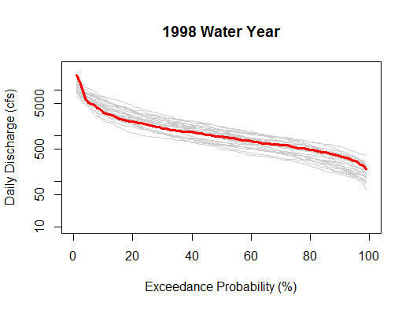
Annual flow duration curves
WY1
WY2
WY3
WYN
Describe variability:
Within years
Between years
These curves show Q1 to Q99 for each water year
Interannual variability can control many ecological processes
Q1
Q2
Q3
Q99

Slide 18
Annual flow duration curves
Describe variability:
Within years
Between years
These curves show Q1 to Q99 for each water year
Interannual variability can control many ecological processes
WY1
WY2
WY3
WYN
Q1
Q2
Q3
Q99

Slide 19
Creating functions
You can create your own functions in R
Let’s code a function that returns the water year for a given date
An R workshop suggests the following function:
WY <- as.numeric(substring(Q_Daily2$Date+92,1,4))
Instead let’s code our own WY_Calc function (back to R script)

Slide 20
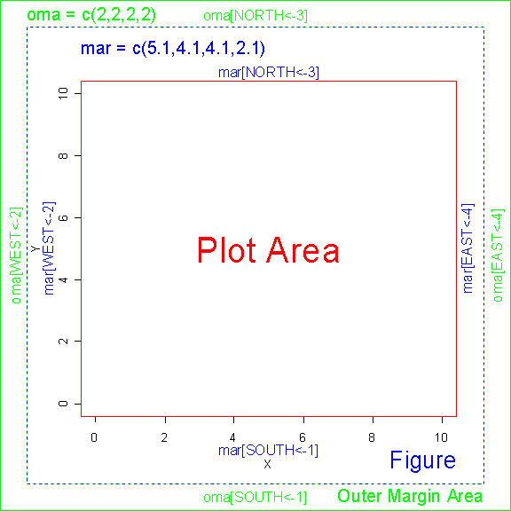
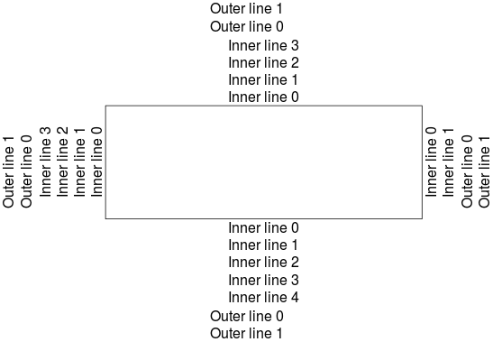
Plot margins in R

Slide 21
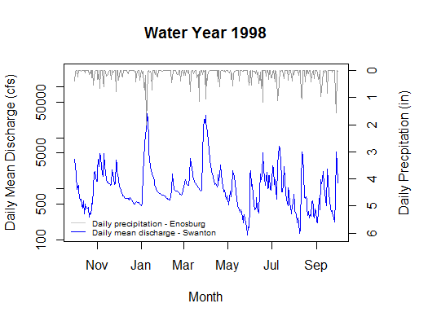
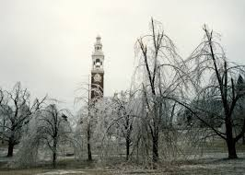
Examining Water Year 1998

Slide 22
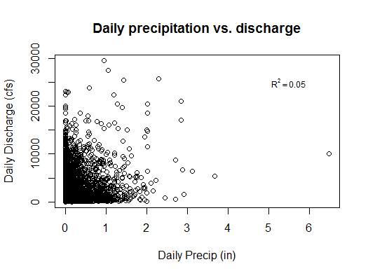
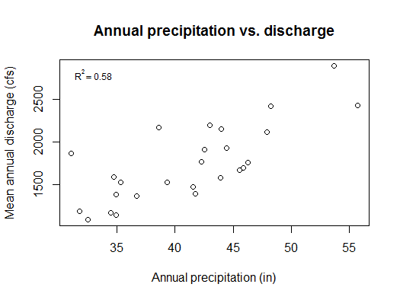
Precip vs. Discharge: Daily vs. annual correlations

Slide 23
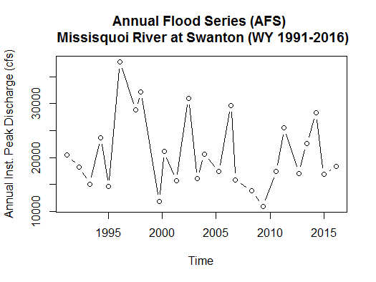
Annual flood series

Slide 24
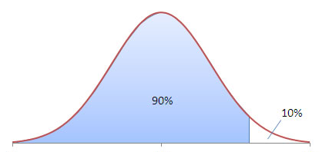



Flood frequency analysis
Often want to know annual flood expected every 1 in T years on average (e.g. 100-year flood)
Annual flood of a percentile p is exceeded 1/(1-p) years
Must make sure watershed conditions are not undergoing long-term change
Lognormal distribution often fits well, related to normal distribution
Official distribution throughout United States is Log-Pearson Type III (LP3)
For p = 0.90, $z_{p}$= 1.281
$$y=ln⁡(Q)$$
$$Q_{p}=exp⁡\left(μ_{y}+z_{p}σ_{y}\right)$$

Slide 25
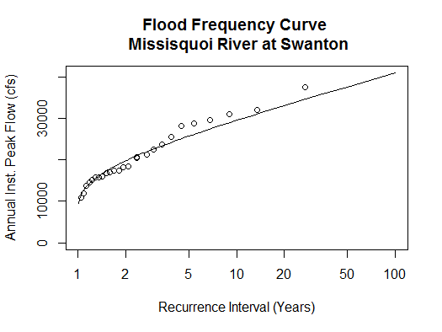
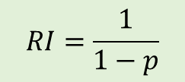
Annual flood series
Be careful with extrapolation beyond flood of record
$$RI=\frac{1}{1−p}$$

Slide 26
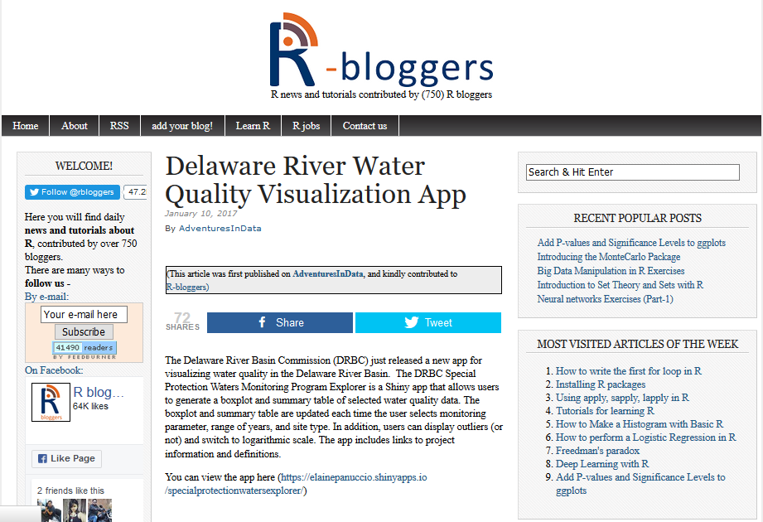
How to learn more R
Help within R (look at examples!)
Free online courses (e.g. Coursera)
Extensive online documentation
Quick-R
Participate in online forums
StackOverflow
Subscribe to blogs and other alerts
Network with users in your research areas
Give a tutorial or workshop to peers!

Slide 27
Thank you!
Happy to help you learn R:
Training on trend analysis and distribution fitting (TBD)
Graphics for posters (consider using ggplot2 package)
Materials will be on my Github site
E-mail me at jory.hecht@uvm.edu

